Slide 1
State of Art in Distributed Query Processing

Slide 2
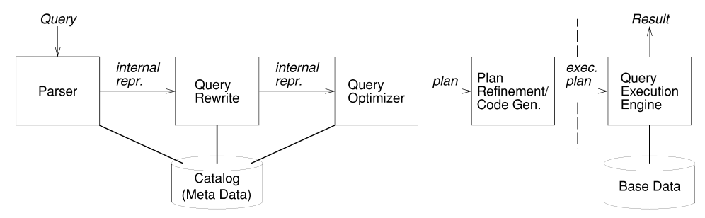
Classic Architecture
Do not use physical state
Site
Annotation
Enumeration algorithm with DP.
Distribution complicates the search space

Slide 3
Cost models
Resource consumption (classic model)
Centralized: CPU, Disk I/O, etc
Distributed: + communication cost
Calibration approach for measuring the cost
Response time model [Ganguly 92]
Consider intraquery parallelism
Pipelined
Independant
Total:260
200
Total:600
130
130
200
200
200
200
200
Notes:
@book{ganguly1992query,
title={Query optimization for parallel execution},
author={Ganguly, Sumit and Hasan, Waqar and Krishnamurthy, Ravi},
volume={21},
number={2},
year={1992},
publisher={ACM}
}
the total usage of every shared resource used by a group of operators that run in parallel is computed. The response time of an entire group of operators that run in parallel is then computed as the maximum

Slide 4
Two-step optimization
At compile time, generate a plan that specifies the join order, join methods, and access paths
Every time before the query execution, transform the plan and carry out site selection

Slide 5
Techniques
Row blocking
send tuples in blocks
Multithreaded query execution[Graefe 90]
Create several threads at a site for intraquery parallelism
Site 1
Site 1
Site 1
Notes:
@book{graefe1990encapsulation,
title={Encapsulation of parallelism in the Volcano query processing system},
author={Graefe, Goetz},
volume={19},
number={2},
year={1990},
publisher={ACM}
}

Slide 6
Techniques
Join with horizontally partitioned data [Epstein 78]
Idea:
Pipeline the computation over the partition
Proper partition reduce the cost, by taking advantage of the knowledge some join results are empty
Notes:
@inproceedings{epstein1978distributed,
title={Distributed query processing in a relational data base system},
author={Epstein, Robert and Stonebraker, Michael and Wong, Eugene},
booktitle={Proceedings of the 1978 ACM SIGMOD international conference on management of data},
pages={169--180},
year={1978},
organization={ACM}
}

Slide 7
Techniques
Semijoins [Bernstein 81]
Idea:
Bloom-hash filter [Valduriez 84]
Eliminate duplicate tuples from pi(A) and send a signature file
Generating additional semijoin in client-server system [Stocker 01]
Notes:
@article{bernstein1981query,
title={Query processing in a system for distributed databases (SDD-1)},
author={Bernstein, Philip A and Goodman, Nathan and Wong, Eugene and Reeve, Christopher L and Rothnie Jr, James B},
journal={ACM Transactions on Database Systems (TODS)},
volume={6},
number={4},
pages={602--625},
year={1981},
publisher={ACM}
}
@article{valduriez1984join,
title={Join and semijoin algorithms for a multiprocessor database machine},
author={Valduriez, Patrick and Gardarin, Georges},
journal={ACM Transactions on Database Systems (TODS)},
volume={9},
number={1},
pages={133--161},
year={1984},
publisher={ACM}
}
@inproceedings{stocker2001integrating,
title={Integrating semi-join-reducers into state-of-the-art query processors},
author={Stocker, Konrad and Kossmann, Donald and Braumandi, R and Kemper, Alfons},
booktitle={Data Engineering, 2001. Proceedings. 17th International Conference on},
pages={575--584},
year={2001},
organization={IEEE}
}

Slide 8
Techniques
Double-pipelined (non-blocking) Hash Join [Ives 99]
Deliver first results as early as possible
A symmetric and incremental join
Xjoin [Urhan 99]
Uses less memory by allowing parts of the hash tables to be moved to secondary storage
Notes:
@article{ives1999adaptive,
title={An adaptive query execution system for data integration},
author={Ives, Zachary G and Florescu, Daniela and Friedman, Marc and Levy, Alon and Weld, Daniel S},
journal={ACM SIGMOD Record},
volume={28},
number={2},
pages={299--310},
year={1999},
publisher={ACM}
}

Slide 9
Techniques
Pointer-based Joins

Slide 10
The possible new techniques in our client-server setting

Slide 11
Is our work different from traditional c/s ones?
Different network protocol
TCP/IP VS websocket / HTTP
Non-relational functional-join based data
Multiple approximation queries

Slide 12
ApplyPlan operation and Set-processable queries
Common pattern for web applications

Slide 13
ApplyPlan Rewriting
blocking
blocking
blocking

Slide 14
Join with horizontally partitioned data
T₁
T_{n}
…
Partitioned F with parameters on the join condition
T₁
T_{n}

Slide 15
Multiple approximation queries
Multiple site annotation per query
Common computation

